Slide 1
Understanding
Convolutional Neural Networks on Protein Secondary Structure Prediction
Guillermo Romero

Slide 2
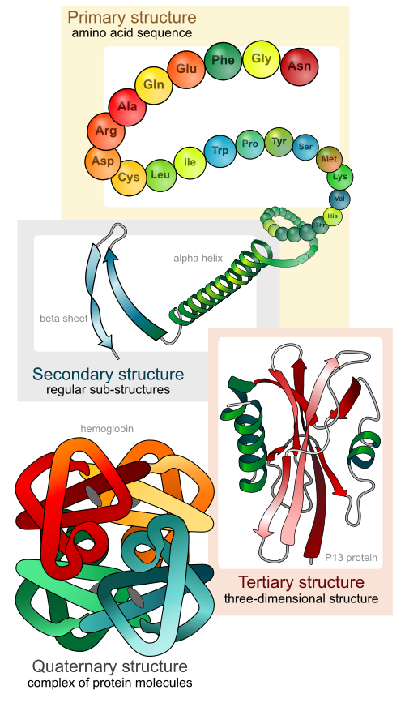
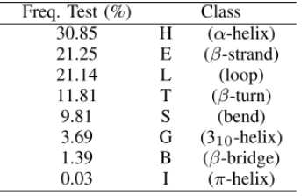
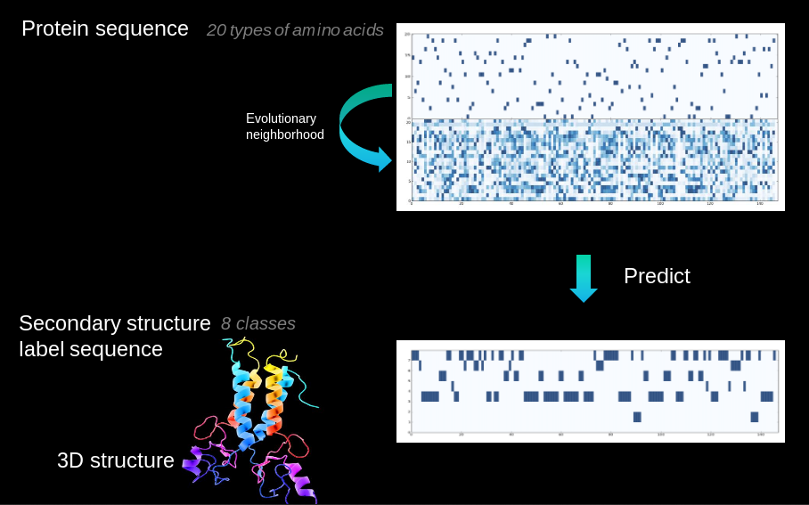
Notes:
- Proteins fold into 3D structure, which determines their function
- Drug, enzyme design,
- High cost of experimental protein structure determination and low cost of DNA sequencing
- 85M proteins discovered, 130k 2ary struct known
- Extremely challenging 3D from sequence alone
- Intermediate step (constrains): secondary structure, local conformations of peptide backbone alpha-helix (3), beta-strand (2), coil (3)
- Structural labelling: many-to-many sequence problem
- Other problems: backbone angle, contact number, solvent accesibility area. Many-to-one: intrinsic disorder prediction, subcellular area

Slide 3
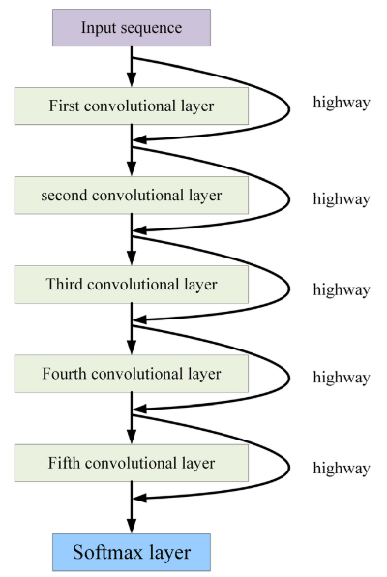
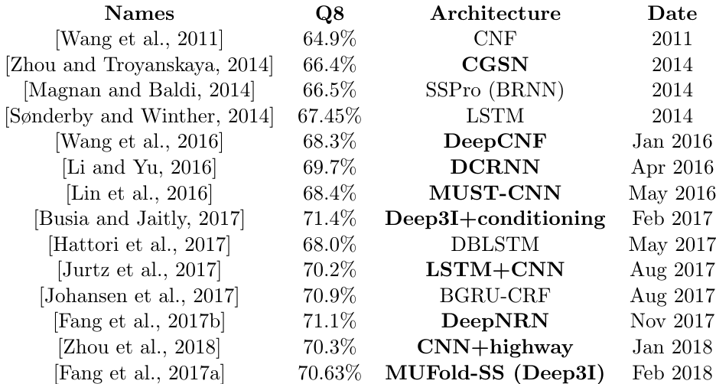
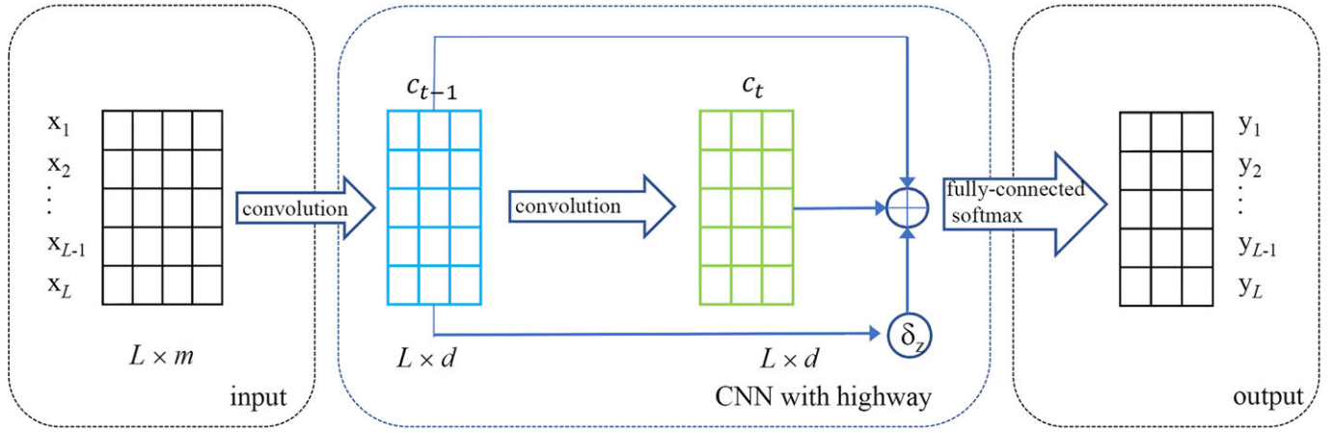
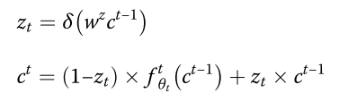
Network of analysis
J. Zhou, H. Wang, Z. Zhao, R. Xu, and Q. Lu, “CNNH_PSS: Protein 8-class secondary structure prediction by convolutional neural network with highway,” BMC Bioinformatics, 2018.

Slide 4
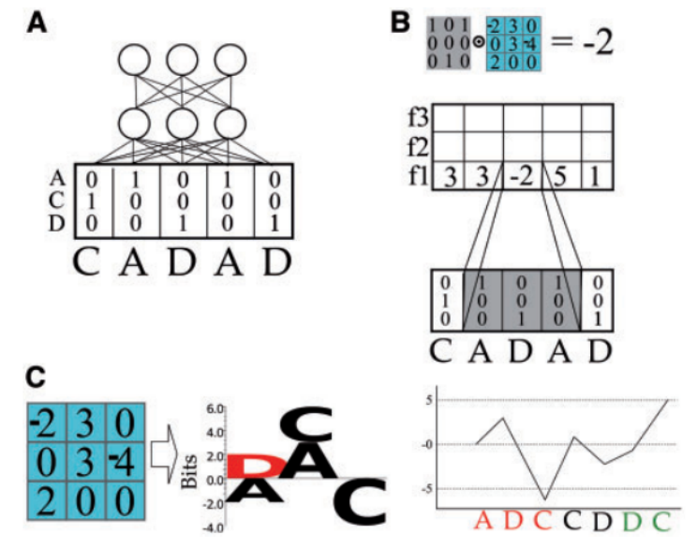
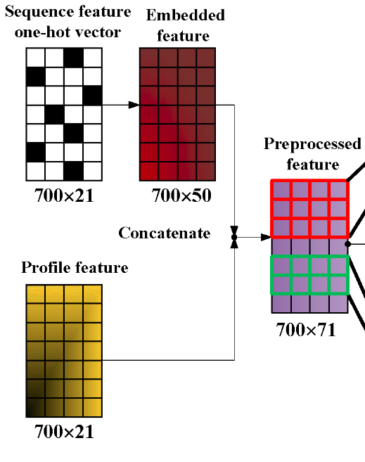
CNNs in protein sequences

Slide 5
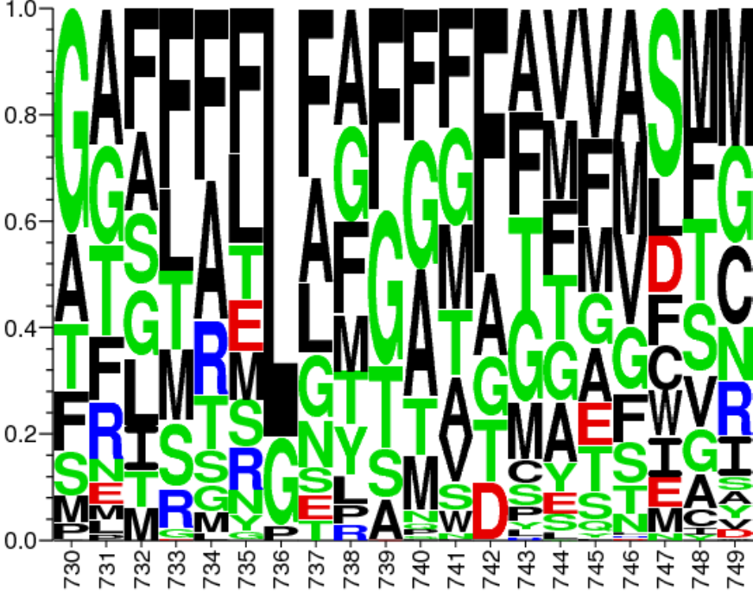
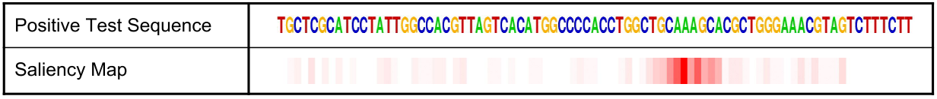
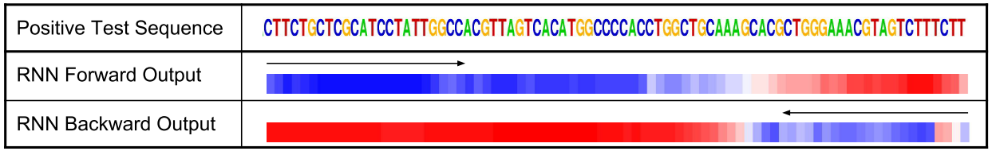
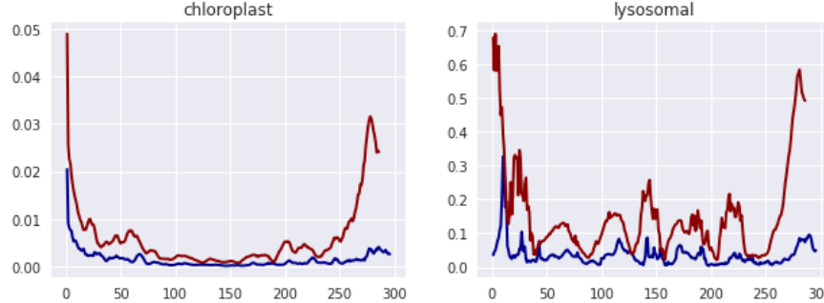
Previous work of model understanding with biological sequence data
A. Fontal, “Neural Networks for Subcellular Localization Prediction,” Wageningen University & Research, 2017.
Protein Subcellular Location Classification
J. Lanchantin, R. Singh, B. Wang, and Y. Qi, “Deep Motif Dashboard: Visualizing and Understanding Genomic Sequences Using Deep Neural Networks,” 2016.
TF binding prediction on DNA sequence

Slide 6
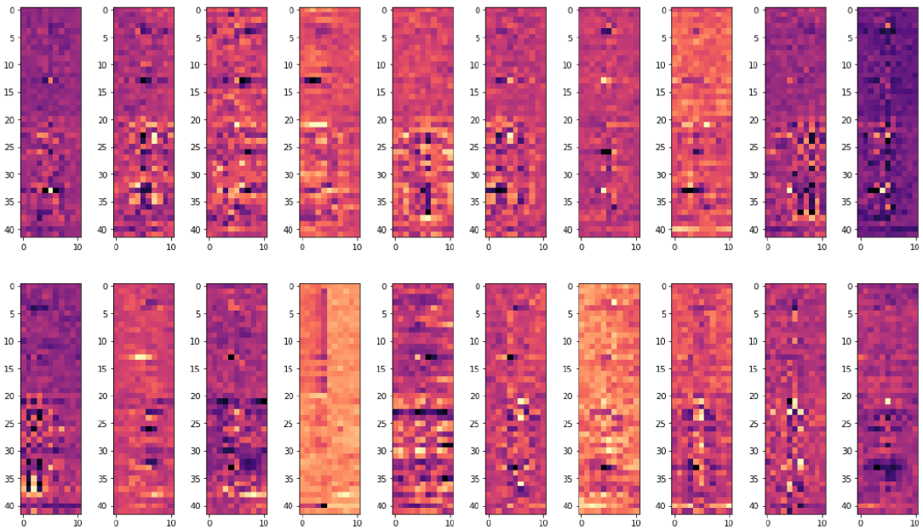
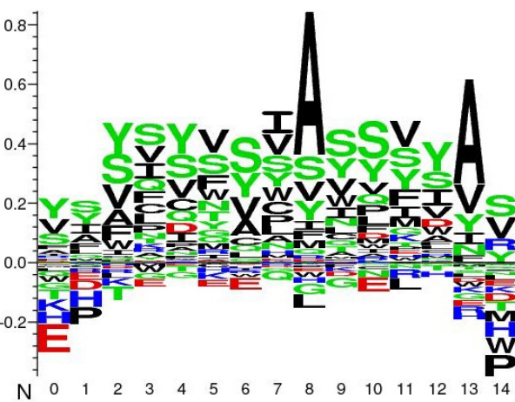
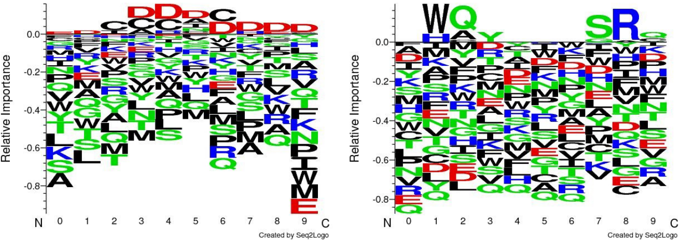
Interpreting first-layer filters

Slide 7

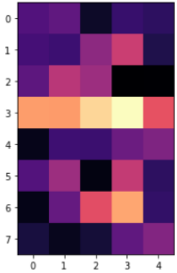
Interpreting higher-layer filters
Class logits
(pre-softmax)
L x 1
Filter
7 x 5
Hidden L x 7
Filters
42 x 11
Input
L x 42

Slide 8
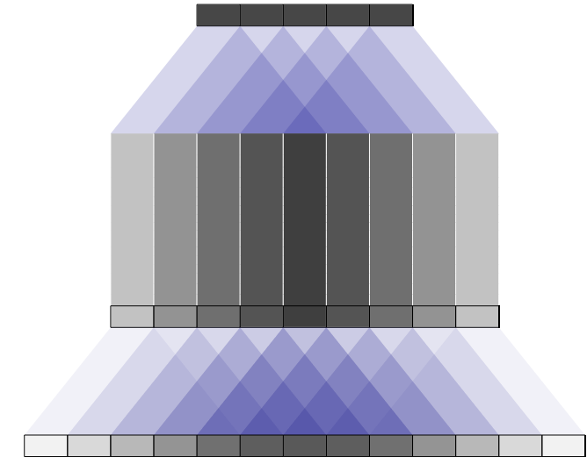
Simple Methods
Finding training and test samples that maximize the objective (+ saliency maps?)
Linear combinations of lower filters

Slide 9

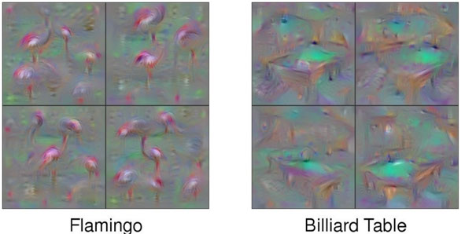
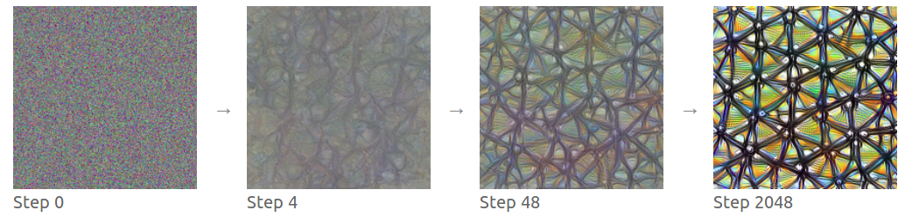
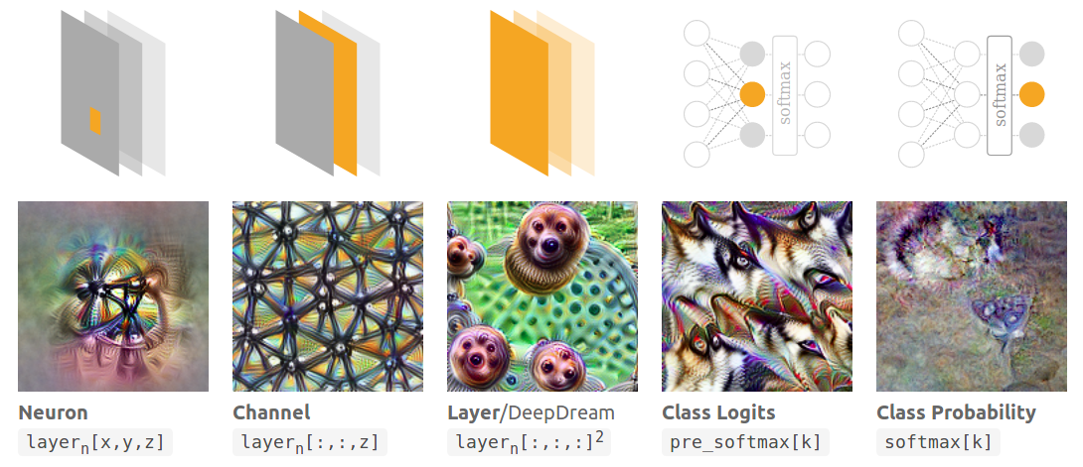
Activation maximization

Slide 10
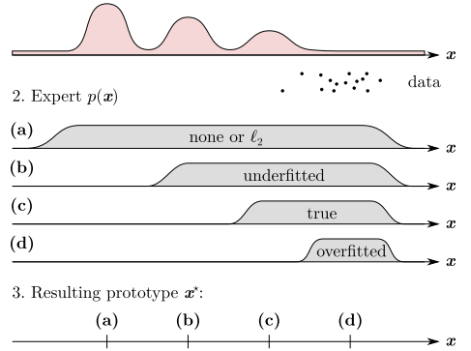
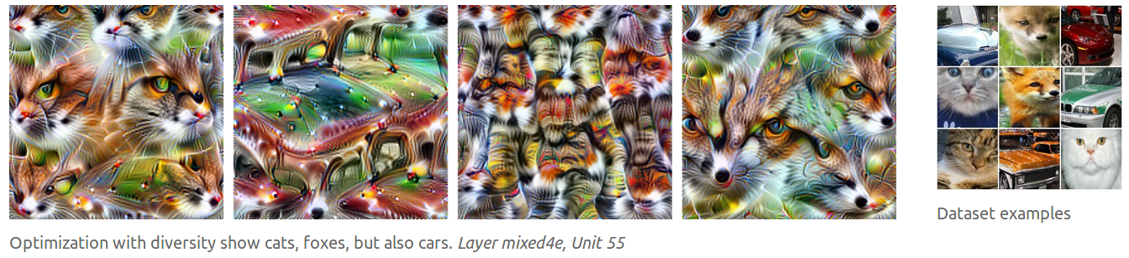
Problems with activation maximization and how to solve them
No natural samples
Diversity not captured

Slide 11
What’s next?
Simple methods: filter inspection of CNNH_PSS and finding maximum activation samples
Implement activation maximization (simple version)
Lucid → tensorflow code for activation maximization on images
Explore diversity
Explore the use of priors

